Slide 1


Competitive Intelligence:
New Market Entrants
Viceroy Preferred Insurance Company
9/23/25

Slide 2


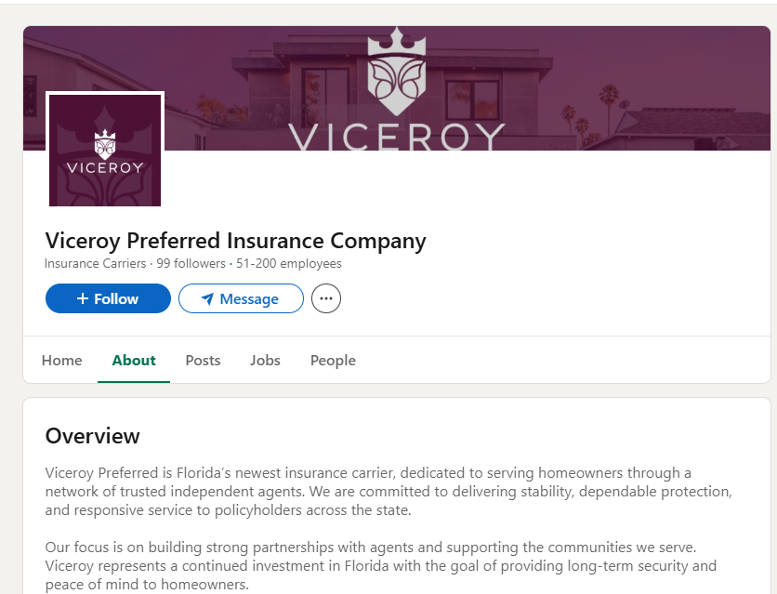
Executive Snapshot
Approved by Florida OIR 8/1/25
Florida-authorized property insurer (corporate form to confirm via OIR company search)
Authorized Florida lines: Homeowners Multi‑Peril and Dwelling Fire
Initial focus: Florida personal residential market
Website: www.viceroyinsurance.com under construction

Slide 3
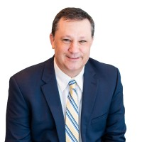
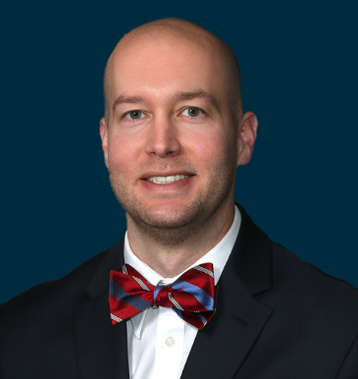
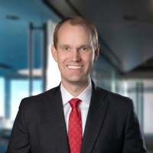

Leadership & Organization
David “Dave” Lockhart
President — ex-President & CFO at Monarch National; former CFO at Security First Insurance and Cabrillo/US Coastal
William Bennett Carter, Jr.
Secretary/Incorporator – General Counsel & Corp Secretary at Monarch National
Steven A. Hale II
Director — General Partner at Hale Partnership Capital Management; Prior CEO/Chair at HG Holdings
Peter Sherman
Director — Founder, Sherman Capital Management; Over 35 years in principal finance & DCM

Slide 4
Strategy, Product & Distribution
Product: Homeowners (HO‑3/HO‑6) and Dwelling Fire expected; confirm via IRFS filings
Distribution: Anticipate agent‑led rollout; watch for producer appointment process and any MGA alignments
Positioning: New Florida entrant post‑reforms; monitor for mitigation credits, roof & water protections, FBC compliance in rate/rule filings
Customer Experience: Modern intake/inspection workflow anticipated; details to be confirmed as filings post

Slide 5
Capital, Regulatory & Risk Framework
Regulatory: Must obtain OIR approval of forms & rates prior to writing; reinsurance program expected before bind
Financial Strength/FIGA: As an authorized writer, FIGA protection applies to eligible lines
Risk Controls: Expect territorial/vintage exposure management common to new entrants; monitor PML posture in early filings
Surplus: Specific dollar surplus not publicly disclosed as of approval date

Slide 6
12‑Month Outlook — Execution & KPIs
Milestones: IRFS forms/rates approvals; reinsurance program placement; ratings visibility; agent appointments live
Commercial KPIs: Appointed agents, quote‑bind conversion, policy count ramp (HO/DF), retention & FNOL cycle time
Risk KPIs: Early loss ratio vs peer cohort; wind/water severity; territory/vintage exposure caps adherence
Capital KPIs: Surplus trend; RBC/adequacy; PML compliance as exposure scales
Watch: Potential participation in Citizens depopulation once operational (TBD)

