Slide 1


Competitive Intelligence:
New Market Entrants
Stand Insurance Exchange
9/22/25

Slide 2


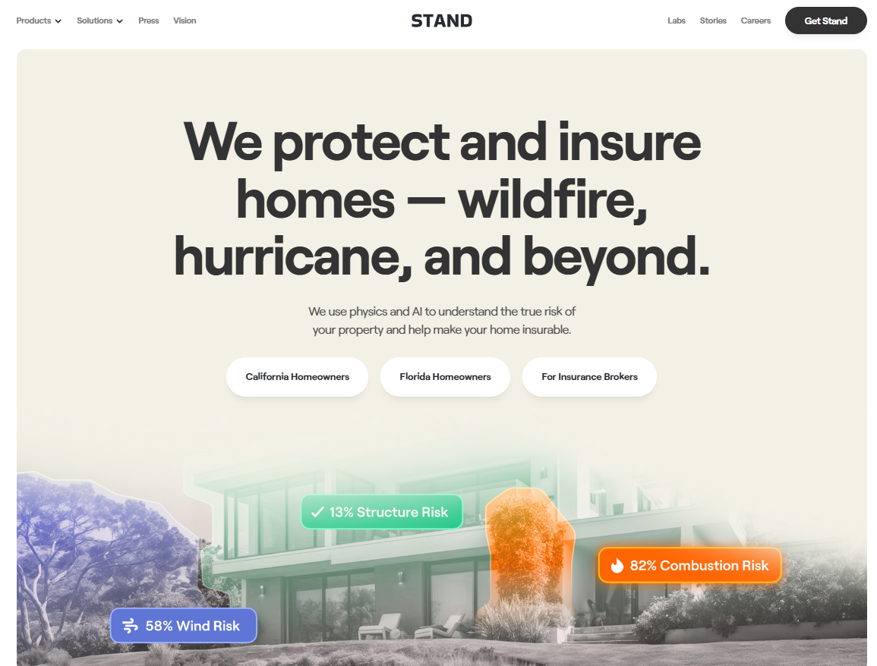
Executive Snapshot
Approved by Florida OIR (Consent Orders: Sept 8 & Sept 15, 2025)
Reciprocal insurer (Florida-domiciled); AIF: Stand Insurance Exchange AIF, LLC; SAC governance
Authorized FL lines: Fire (0010), Allied Lines (0020), Homeowners Multi‑Peril (0040), Inland Marine (0090), Other Liability (0170)
Citizens Depopulation: Approval to assume up to 25,000 personal residential multi‑peril policies; initial target ~Dec 16, 2025; comparable coverage requirement
HQ: 335 N. Monroe St., Tallahassee, FL
Website: https://www.standinsurance.com

Slide 3




Leadership & Organization
Dan Preston
Chairman / CEO / President / Secretary — ex‑CEO Metromile; Board member at Dave Inc.
Jason Mueller
Co‑founder & Chief Product Officer — ex‑CPO Policygenius; ex‑VP Product Pendo; founder of MyFit (acq. by Naviance)
Sam Shank
Co‑founder — ex‑CEO & Co‑founder HotelTonight (acq. by Airbnb)
Bill Clerico
Co‑founder — ex‑CEO/Founder WePay (acq. by JPMorgan); Managing Partner at Convective Capital

Slide 4
Strategy, Product & Distribution
Mitigation‑first, tech‑forward: physics/AI (digital twins, advanced modeling) to guide property hardening & pricing credits
Initial focus: HO‑3; monitor IRFS for HO‑6/DP; emphasize mitigation credits (roof resilience, secondary water, FBC compliance)
Distribution: Agency-led; broker appointment portal live
CX & Ops: Data‑driven underwriting, streamlined intake/inspection; prevention‑oriented engagement
Appointing new agents in FL & CA

Slide 5
Capital, Regulatory & Risk Framework
Non‑assessable policies; 10% surplus contribution retained as policyholder surplus. Surplus not fully disclosed.
Statutory deposits: $300k (§624.411) + $100k reciprocal deposit (§629.121)
Reinsurance & PML: Program must be placed pre‑launch; annual 1‑in‑100 PML filings in first 3 years
Citizens depop execution contingent on reinsurance, rating readiness, and comparable coverage parity

Slide 6
12‑Month Outlook — Execution & KPIs
Milestones: IRFS approvals; reinsurance panel finalized; Citizens assumption readiness (~Dec 16); FIGA/ratings checkpoints
Commercial KPIs: Bound policies, appointed agents, mitigation credit adoption, quote‑bind conversion
Risk KPIs: Modeled vs actual LR; wind/water severity; territory/vintage exposure caps adherence
Capital KPIs: Subscriber surplus contributions; surplus/RBC trend; PML compliance as portfolio scales

