Slide 1


Competitive Intelligence:
New Market Entrants
Patriot Select
9/26/25

Slide 2


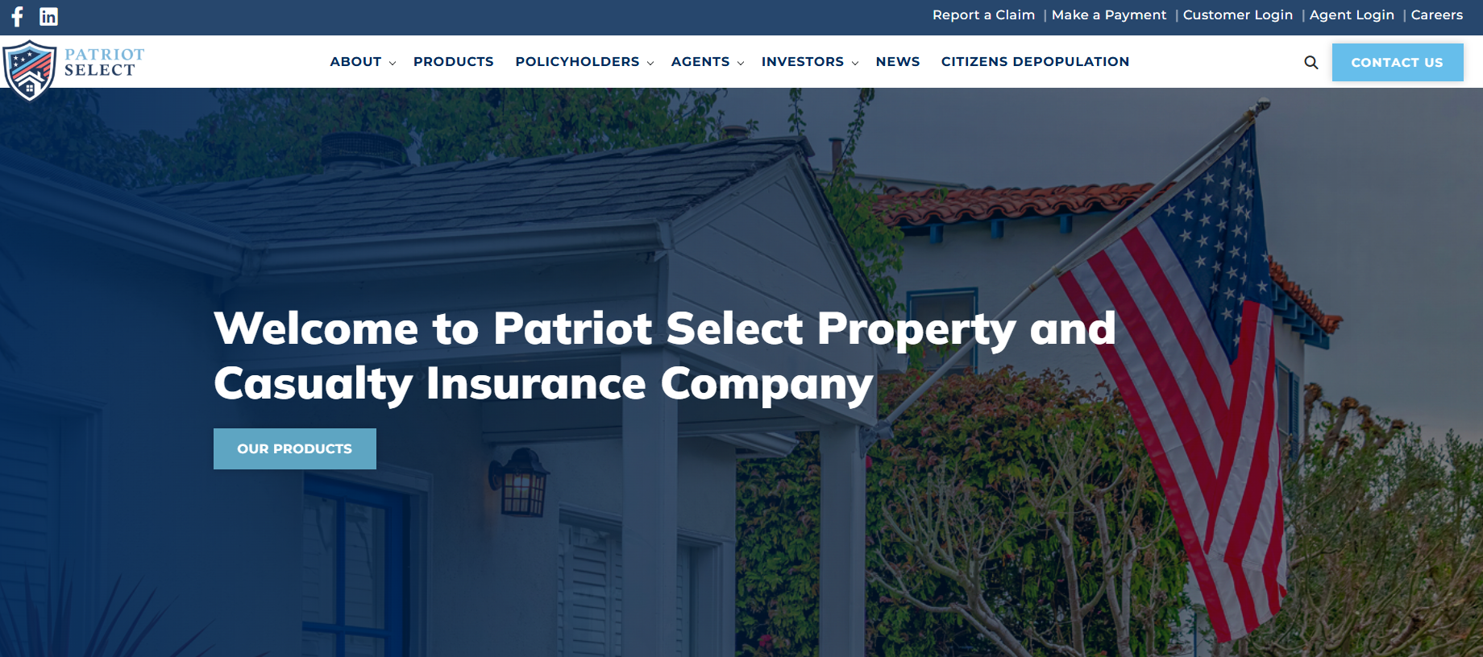
Executive Snapshot
Patriot Select Property & Casualty Insurance Company — Florida‑domiciled homeowners carrier; HQ St. Petersburg, FL
Mission: reliable, transparent property insurance solutions for Florida homeowners backed by seasoned leadership and resilient capital
Financial Stability Rating: A (Exceptional) by Demotech
Regulatory status: OIR approval to operate; Citizens depopulation approvals including up to 30,000 policies in Q4 2025
Website: www.patriotselect.com
Sources: patriotselect.com (About, News); Florida OIR orders; Insurance Journal; Business Observer; Demotech; LinkedIn profiles

Slide 3
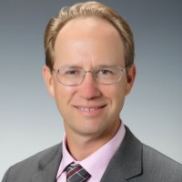
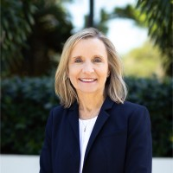
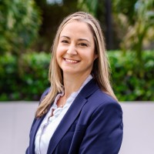
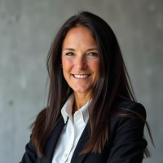
Leadership & Organization
John W. Rollins
Chief Executive Officer; Former Chief Risk Officer & Board Member at Citizens
Kelly Booten
Chief Operating Officer.
Ex-COO at Citizens
Marcia Lamb
CFO
Ex-Controller at Kin Insurance
Emily Craig
VP, Claims
Prior Director at Anchor Insurance

Slide 4
Strategy, Product & Distribution
Product: Florida homeowners (HO) with technology‑enabled service; blend of traditional claims handling and modern tools
Distribution: Independent agents; building statewide footprint with takeouts and open‑market new business
Reinsurance: Full property cat program placed (June 2025) to support growth and volatility management
Growth levers: Citizens takeouts (June/Q4 waves), agency appointments, and disciplined underwriting
Sources: patriotselect.com (About, News); Florida OIR orders; Insurance Journal; Business Observer; Demotech; LinkedIn profiles

Slide 5
Capital, Regulatory & Risk Framework
Capitalization: ~$29mm initial capitalization reported at launch; targeting 40k PIF by YE 2025
Regulatory: Florida OIR consent orders/approvals (Jan–Jul 2025); Citizens depopulation approvals
Risk: Florida‑first footprint; focus on rate adequacy, mitigation, and reinsurance discipline
Operations: Customer & agent portals; service/claims processes designed for speed and transparency
Sources: patriotselect.com (About, News); Florida OIR orders; Insurance Journal; Business Observer; Demotech; LinkedIn profiles

Slide 6
12‑Month Outlook — Execution & KPIs
Commercial: Agency appointments; quote‑to‑bind; PIF from takeouts vs. open market; retention
Risk: Modeled vs. actual LR; cat severity; inspection pass; litigation rate; water/wind loss frequency
Capital/Compliance: Surplus trajectory; RBC; reinsurance renewals; DOI reporting cadence
Brand & CX: NPS/CSAT; claim cycle times; digital adoption for payments, e‑delivery, and FNOL

