Slide 1


Competitive Intelligence:
New Market Entrants
Incline National
9/26/25

Slide 2


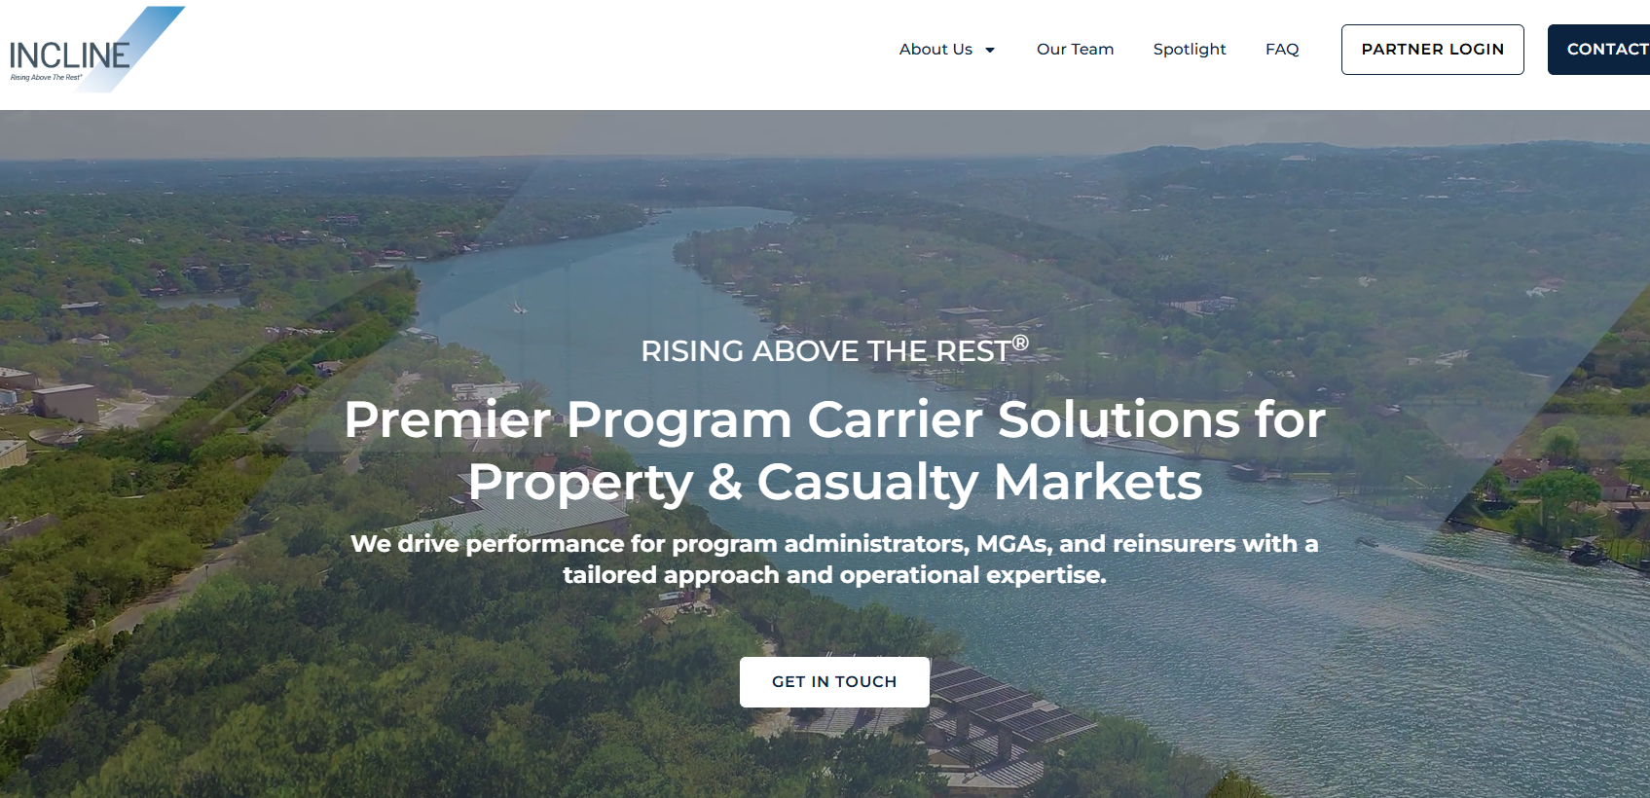
Executive Snapshot
Approved by Florida OIR (Consent Order: Apr 17, 2025)
Foreign insurer (California-domiciled); part of Incline P&C Group (Austin, TX HQ)
Authorized FL lines: Allied Lines (0020), Homeowners Multi‑Peril (0040), Inland Marine (0090), Workers’ Compensation (0160), Private Passenger Auto Liability (0192), Private Passenger Auto Physical Damage (0211)
Launch focus: Florida personal residential HO via agency distribution; filings/reinsurance in flight
Website: www.inclinepc.com
Sources: Florida OIR Consent Order (Apr 17, 2025); Incline P&C Group public leadership pages

Slide 3
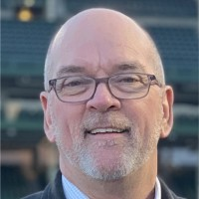
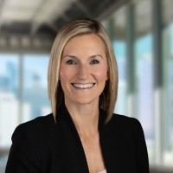

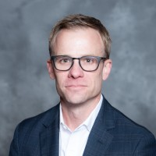
Leadership & Organization
Chris McClellan
President & CEO
Lauren Wiedenfeld
CFO
Sheel J. Patel
Chief Risk & Strategy Officer
George Gorney
Co‑founder — ex‑CEO/Founder WePay (acq. by JPMorgan); Managing Partner at Convective Capital

Slide 4
Strategy, Product & Distribution
Program‑carrier discipline in FL personal residential; agency‑led distribution with pre‑bind inspections
Mitigation‑forward underwriting: verify roof condition, water controls, and wind/WUI hardening for credits where filed
Target product: HO‑3 to start; monitor IRFS for forms/rates and any HO‑6/DP expansion
Claims & Ops: TPA/inspection vendor alignment; catastrophe response plan and reporting per consent order

Slide 5
Capital, Regulatory & Risk Framework
Consent Order OIR 2025‑49 signed Apr 17, 2025 (Commissioner Michael Yaworsky); company execution by President & CEO Apr 16, 2025
Statutory deposits and FL compliance conditions prior to binding; proof of reinsurance placement required
Aggregation & PML governance with 1‑in‑100 reporting during initial operating period
Ratings/readiness checkpoints aligned to Florida market entry
Sources: Florida OIR Consent Order (Apr 17, 2025); Incline P&C Group public leadership pages

Slide 6
12‑Month Outlook — Execution & KPIs
Milestones: IRFS filings cleared; reinsurance program finalized; agency appointments live; claims vendor stack operational
Commercial KPIs: Bound policies, appointed agents, quote‑to‑bind conversion, retention
Risk KPIs: Modeled vs actual LR, cat severity trend, exposure caps by county/roof age, inspection pass rates
Capital/Compliance KPIs: Surplus & RBC trajectory, deposit/rule compliance, consent‑order deliverables on time

