Slide 1


Competitive Intelligence:
New Market Entrants
Florida Insurance & Reinsurance Company (Florida Re)
9/26/25

Slide 2


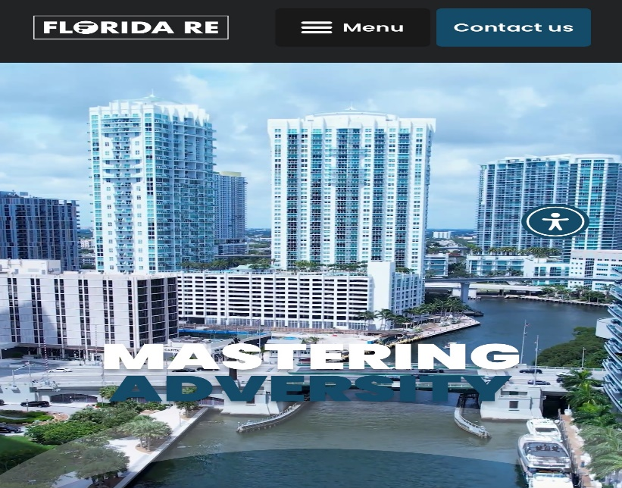
Executive Snapshot
Florida Insurance & Reinsurance Company (Florida Re) — Part of MNK Group; HQ Tampa, FL
Florida‑domiciled reinsurer and specialty property insurer focused on disciplined, sustainable risk transfer
Demotech Financial Stability Rating: A (Exceptional)
Primary focus: Commercial residential (condos, apartments, HOAs) and coastal commercial property; Florida‑first footprint
Website: https://floridare.us
Sources: floridare.us (About/Insurance/Reinsurance); Demotech; MNK Group leadership pages; CUO announcement

Slide 3
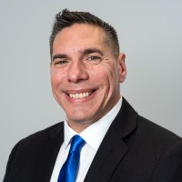
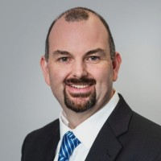
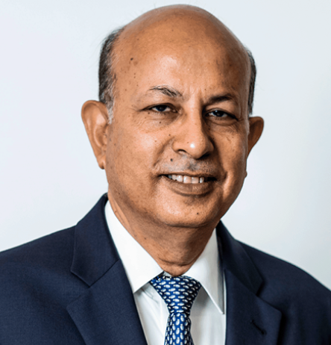
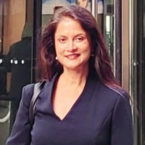
Leadership & Organization
Alvaro A. Ortiz
President & CEO
Ex Chief Data Officer at Frontline
Jeremy Baczkiewicz
Chief Underwriting Officer
Ex-SVP Underwriting & Product at Slide
Manoj Kumar
Group CEO, MNK Group
Chaitali Roy
Managing Director, MNK Group

Slide 4
Strategy, Product & Distribution
Insurance: Commercial Property program for residential condos & HOAs; ISO Special perils with optional coverages (e.g., Ordinance or Law)
Reinsurance: Catastrophe XoL, Risk XoL, Proportional treaty, Reinstatement Protection Plans (RPPs)
Target clients: Insurers (small–mid), captives/cells, RRGs, MGAs — typical line sizes $1m–$5m
Distribution: Appointed agents & specialty partners; mitigation emphasis (secondary wind characteristics) for preferred risks
Sources: floridare.us (About/Insurance/Reinsurance); Demotech; MNK Group leadership pages; CUO announcement

Slide 5
Capital, Regulatory & Risk Framework
Demotech A (Exceptional) rating supports market access and counterparty confidence
Technology‑driven underwriting: AI‑powered geospatial data; AIR & RMS catastrophe models; automation for precision underwriting
Aligned risk culture: risk‑sharing with MGA/captive partners; focused accumulation controls (Florida, California, coastal states)
Product innovation: blanket deductible option for multi‑location/commercial residential insureds
Sources: floridare.us (About/Insurance/Reinsurance); Demotech; MNK Group leadership pages; CUO announcement

Slide 6
12‑Month Outlook — Execution & KPIs
Commercial: Appointed agent growth; condo/HOA program adoption; quote‑to‑bind and retention trajectory
Risk: Modeled vs actual LR; cat volatility vs plan; inspection pass rates; mitigation credit utilization
Capital/Compliance: Maintain A rating; finalize reinsurance panels; aggregation caps by ZIP/vintage; bordereaux/reporting cadence
Go‑to‑market: Build presence with property managers/associations; expand captive and reinsurance partnerships

